Slide 1
LDA and -na
Local agreement or agreement by percolation ABP/concord by percolation CBP, either way it can be simpler than the literature has treated it

Slide 2
Basic properties of LDA
Properties of Agreement in Hindi-Urdu
Language Universal: “Agreement can only go upwards” (Mahajan 1990:92)
Specific to Hindi-Urdu: Agree with the highest unmarked DP: “If the matrix verb is not a perfective participle, then it shows agreement with its own subject.” (Mahajan 1990:91)
Properties of LDA in Hindi-Urdu
“LDA is only possible with arguments of non-finite complements.” bhatt-The Phenomenon of Long Distance Agreement(lecture)-2003.pdf
Optionality: “The agreement of the object and the infinitive in the embedded clause is optional. If the infinitive does not agree with its object, the matrix verb cannot show agreement with the lower object.” (Mahajan 1990:90) (other authors: Hook 1979,Davison 1988, Butt 1995)
Parasitic: “If the lower verb does agree with the object, then the matrix verb must also show agreement with the lower object.” (Mahajan 1990:91) ``When the matrix verb has a nominative subject, LDA is not possible. In these cases infinitival agreement is also not possible… It can be concluded … that infinitival agreement is parasitic on LDA.” (Bhatt 2005:762)
LDA happens even if there is scrambling or intervening adverbs (Bhatt 2005:766)
Emebedded NA doesn’t agree with the subject, unlike other verbal forms. ``We find an embedded object agreeing with the matrix T…however, the reverse process, where the infinitival verb agrees with the matrix subject, is not attested.” (Bhatt 2005:774)
Subjects are not found in the embedded complement. (Bhatt 2005:766)(Mahajan 1989)
Optionality and parisitic are both are subject to dialectal variation

Slide 3
LDA
Hypothesis 1: T agrees with embedded object (Mahajan 1989,1990, Davison Bhatt 2005)traditional, causes agree to be revised)
Hypothesis 2: embedded verb agrees with object, T agrees with embedded verb (Butt 1993, not standardly adopted because….?)
Hypothesis 3: there is concord upwards from the object…based on the V projecting. How ever the concord domain is defined in DPs should be with the functional heads above a V. (needs a theory of concord based on projection…)

Slide 4
Basic Accounts
Mahajan 1990: Imperfective participle assigns acc, perfective cannot assign case, infinitive optionally assigns case. In LDA the object moves to AgrO to get case.
Butt 1993: LDA is the result of two local agreement relations. One of the embedded object and NA, the other of the matrix verb and its complement (the NA phrase).
Bhatt 2005: AGREE doesn’t require a goal to be active. Thus, the matrix verb can agree with the embedded object, despite the agree relation between the embedded object and NA. The probing of T down to the objects passes through the INF and creates a dependency which accounts for the dialects where INF and T don’t agree independently.

Slide 5
Mahajan 1990 Basics
Perfective participles never assign case (similar to an account of English perfect participles ``have+en’’ Hoekstra 1994)
Imperfective participles always assign case
Infinitives optionally assign case
AgrO is present for each aux
There is a PRO in the embedded clause which doesn’t block the objects movement.
In the perfect, the object moves up to spec AgrO where it agrees and gets ACC case.
In the imperfect, the participle assigns ACC case to the object in situ and there is no object agreement.
When the infinitive assigns case, the object remains in situ and there is no agreement.
When the infinitive doesn’t assign case the object raises to specAgrO of the embedded clause and causes agreement with the infinitive. It is still unable to get case so it raises to the matrix SpecAgrO where it gets case from T.
Make 4 structures

Slide 6
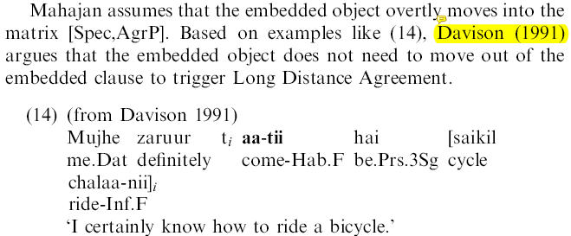
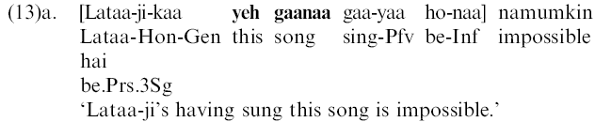

Problems with Mahajan 1990
Conceptual Problem: we now believe that object case is licensed by vP. This is below the aspect/infinitive morphology. We aspect/finite/tense to have nothing to do with the object case. (Bhatt 2005:764) I think this is a non-problem, so I will not discuss it.
Empirical Problem: Perfect participles embedded under infinitival have overt objects, shown in Bhatt 13a. (Under Bhatt’s analysis where infinitival cant license object case and the matrix T is too far away) this would mean perfectives do assign case to their objects. (Bhatt 2005:765)
Empirical problem: infinitival and optional object case, see section 4.2.2 (Bhatt 2005:766) ``optional inability of infinitives to assign accusative is hard to argue against, but it is also unclear what would constitute independent evidence for it” (bhatt-The Phenomenon of Long Distance Agreement(lecture)-2003.pdf :8)
Empirical problem: there are cases provided by Davison 1991 where overt movement would destroy the constituency of the object and infinitival which are scrambled to the end of the clause.
Empirical problem: If matrix T can license the object case in the embedded clause it should be able to license the embedded subject too such as Mohan in 16. (I think that subjects are impossible for another reason, see my notes in the pdf.)

Slide 7
Butt 1993 Basics
NA itself is underspecified for its grammatical category
There appear to be two different internal structures for NA phrases, one with an nouny structure, the other with a verby structure.
Butt says that the NA phrase are externally an NP, so the matrix verb can agree with it.
  It can be case marked
  It can have valaa which attaches to N/Adj, not participles/finite verbs
  It can have genitive subject
  It can appear where a DP can
(She seems to have only used NA phrases with internal nouny features to show this.)
The verby internal properties include a case that would be assigned by a verb (nom/acc/dat?) [DP-NOM/DAT root-NA], allows adverbs and can get its gender features from its argument. (44a)
The nouny internal properties include noun case (gen) [DP-GEN root-NA] allows adjectives(?) and has inherent masc default gender. (44b)
LDA is present when the internal structure is verby and the NA gets its gender from the argument it case licenses.
LDA is not present when the internal structure is nouny. The NA has no source for gender as it is the head, thus it is the masculine default. This could be similar to other languages, french spanish, german where the gerund has one set gender.(?)

Slide 8
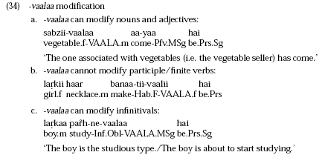
Butt examples:

Slide 9
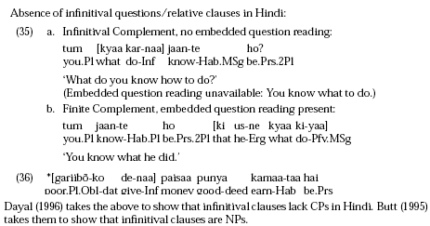
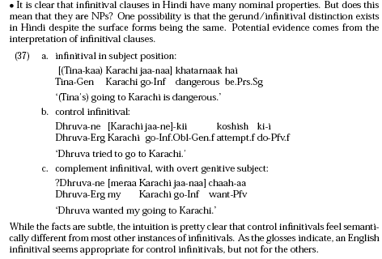
Problems with Butt (from Bhatt’s lecture)
Im not sure what the point was with this one: if it’s a problem or not.
There is a semantic feeling about subject infinitives and complement infinitives.
Butt cant handle the parasitic facts
(against butt 1995)Noun-incorporation wont work to get the optionality

Slide 10
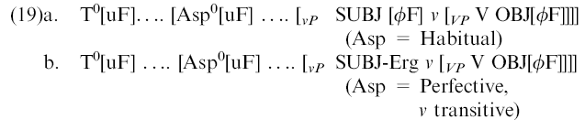
Bhatt 1995 Basics
Agreement and case are independent, this is needed to block the matrix T from assing case to mohan in the embedded subject position of 16
Bhatt’s AGREE differs from Chomksy’s 1998 Agree in that the Activity Condition (have unvalued features) on goals is a relevant for Move, not agreement.
AGREE is the process by which a head X^0 (the Probe) with a complete set of unvalued uninterpretable features identifies the closest Y^0/YP in its c-command domain with the relevant set of visible matching (i.e. nondistinct) interpretable features (the Goal), and uses the interpretable features of Y^0/YP to value its uninterpretable features. (Bhatt 2005:758)
Participle agreement is in 19

Slide 11
Now turn to some of the details
First I will look at how the different proposals handle the optionality and the parasitic dialects
Then I will try to compare the structures proposed by each author to see what do they have in common.
The analysis of LDA crucially rests on the function of NA.
So I will look at some additional properties of LDA that are mentioned in passing in Bhatt and Butt, try to use these facts to determine whether there are two NA.
There appear to be two internal structures: there are two possibilities
There are two na, with overlapping distribution
There is one na, with complementary distribution

Slide 12
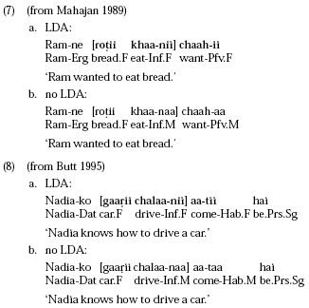
Optionality Examples

Slide 13
Optionality
In the cases where LDA doesn’t happen but is possible:
Mahajan 1990: The infinitive optionally assigns acc case. When it assigns case there is no agreement.
Butt 1993: NA is underspecified as a N/V and takes its specification from the environment. NA is internally a noun with its own default masculine gender –aa.
Bhatt 2005: The difference is restructuring vs non-restructuring. The NA is a non-restructuring infinitive with a PRO functioning as a closer goal to the Matrix T, thus blocking LDA.
Other Ideas:
-specificity
-psuedo-incorporation (Butt 1995)

Slide 14
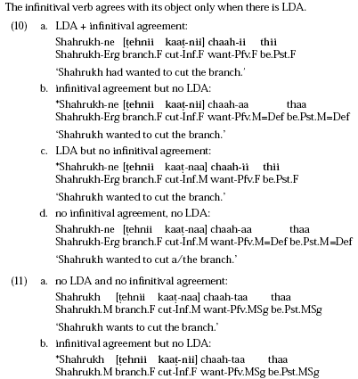
There are two types of languages, parasitic and non parasitic
Examples of parasitic pattern (Bhatt 2005 6)

Slide 15
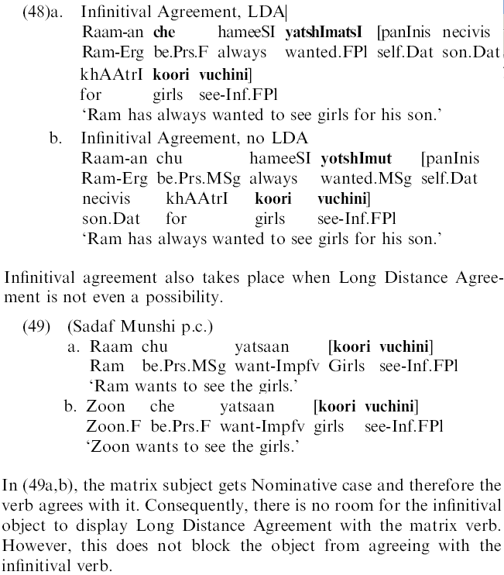
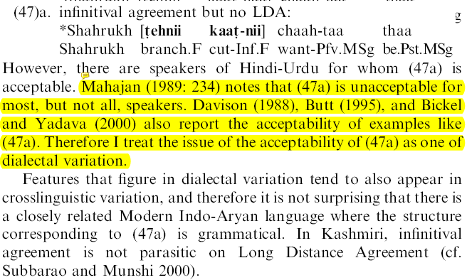
Examples of non-parasitic languages
Make examples for Lahori Urdu
Kashimri (Bhatt 2005)

Slide 16
Parasitic
In some dialects of Hindi-Urdu it is impossible for the embedded object and NA to agree, without the matrix verb also agreeing.
Butt 1993 works on Lahori Urdu (a non-parasitic dialect) so she doesn’t discuss the “parasitic” properties of LDA.
Bhatt 2005 derives the non-parasitic dialects and languages by adding a parameter; in the non-parasitic languages the INF obligatorily functions as a Probe for AGREE. Otherwise ``it is parasitic on Long Distance Agreement.” (Bhatt 2005:790)
  Parasitic: T probes for valued interpretable features, on its way it encounters the participial which has unvalued uninterpretable features too, a dependancy is created between them and T probes further for valued interpretable phi features until it gets to the object. Thus the infinitve agreement is parasitic on LDA. (Bhatt 2005:769)
Bhatt explicitly excludes agreeing with the NA clause: ``Regardless of the language, agreement is only possible with an XP that has its own phi-features and not one that has itself acquired its phi-features by agreement.” (Bhatt 2005:790) This falls out from the definition of Chomksy’s Agree and Bhatt’s modification AGREE: ``a Probe can only use interpretable features to value its unvalued features.” (Bhatt 2005:789)

Slide 17
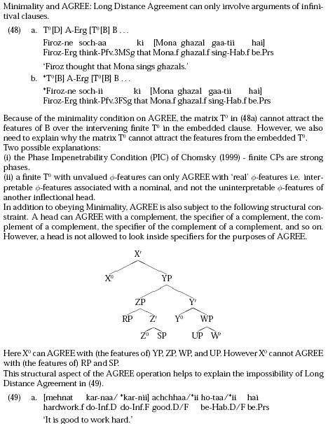
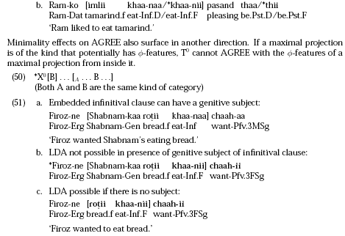
Minimality and PIC (Bhatt lectures)

Slide 18
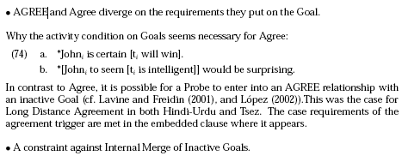
Summary of Basic Properties
Its optional, subject to dialectal variation and crucially rests on the grammatical function of na.
Although Bhatt’s removal of the Activity Condition from Agree is interesting and maybe true, his controversial attempt to divorce case from agreement is be based on shaky/fragile data. Without a more involved understanding of NA, LDA doesn’t sound like a good candidate for revising the mechanisms of the theory, particularly when trying to separate case and agreement.
See below from (Bhatt lecture)

Slide 19
Debate between Hypothesis 1 and Hypothesis 2
In the rest of the paper I will entertain a version of Hypothesis 1 and Hypothesis 2, barring evidence that the Na phrase isnt an NP externally I will adopt Hypothesis 2 as the simplest.
Ultimately I would like to opt for Hypothesis 1, but redefined in terms of Hypothesis 3. I follow similar ideas where c-command, a top down notion, is replaced by a percolation/projection, a bottom up notion which is more in keeping with current views of structure building. I would like to appeal to percolation/projection as a replacement for c-command in Agree as well. I would like to draw on the apparent common ground of a one to many relation ship found in DP agreement and LDA. LDA is infact local in the sense that there is uninterupted verbyness percolating all the way up to T from the NA head. Agreement as Projection/percolation will allow for a syntactic account of the Concord Domain in DPs which I suspect may be similar to what I would call the Concord Domain in LDA and predicates+auxiliaries in Urdu and Bantu languages. Having this new definition of a domain, I would like to see if the label projecting cant capture phases as well. I suspect that Hornstein is working on this.
That said I will look in to the feasibility of Hypothesis 2, with heavy descriptive/empirical emphasis.

Slide 20
Explorations of NA
In this section I will look for an overlapping distribution which would show conclusively that there are two NA.
If all NA phrases are NPs externally Butt’s analysis is still applicable. The data for the parasitic languages can be explained by obligatory agreement between the matrix verb and its complement.
On the other hand, it maybe worthwhile to ask in what ways does agreement with restructuring predicates/light verbs differ from auxiliaries.

Slide 21

Add acc-ing, and or Gerunds as Complements of Perception Verbs from pires.
i. The subject of a CG may be an empty category (standardly analyzed as a PRO) or a lexical DP marked with Accusative or Nominative Case:
ii. CGs need to occur in Case marked positions:
iii. CGs do not behave as ECM complements, which is indicated by the fact that they do not occur as complements of standard ECM verbs like believe nor allow raising of their subjects to the subject position of a passive structure:
iv. CGs do not occur as complements of subject raising verbs:
v. The subject position of a CG must be filled out in the derivation, either by a lexical DP that may further move, as I suggest here, or by a pure expletive there. In standard terms, that means that a CG of needs to check an EPP feature in the [Spec, TP]:
i) It carries an uninterpretable Case feature that needs to be checked. (thats why the fact that they need to occur in Case marked position, this is the only property they have with DPs)
ii) It has an EPP feature that needs to be checked. (relate the behavior of clausal gerunds to the one of to-infinitives.)
iii) It enters the numeration as f-defective. (relate the behavior of clausal gerunds to the one of to-infinitives.)(necessary only because of the implementation of feature checking in Chomsky (1999))
iv) When DP merges in the Spec TP of the CG to check the EPP feature, the DP transfers its f-features (by agree) to T0. (necessary only because of the implementation of feature checking in Chomsky (1999))
v) T0 of a CG cannot check the uninterpretable Case feature of the embedded subject while its own uninterpretable Case feature is still unchecked. (direct consequence of property (i). After the uninterpretable Case feature of the embedded T0 has been checked in the derivation, T0 is able to check the Case feature of its subject DP)
CGs have a feature that is instrumental in licensing the case of their subject. LIke reuland this feature is realized by the AGR marker on the CG head (ie ing?)
CGs behave very much like infinitives in Portuguese and arguably in Basque,
Case Percolation or Case transmission: whole subordinate clause received Case and that Case could then be transmitted to its subject.
If the infinitive lacks structural Case (Basque) or inflectional morphology (Portuguese), OC interpretation is required and lexical DPs are not allowed.
Basque and Portuguese display two types of infinitives. One type displays special overt morphology that licenses lexical subjects or null subjects with NOC properties (analyzed as pro). The other type lacks that overt morphology and only licenses null subjects with OC properties (standardly analyzed as PRO).
account I propose here requires the CG to obligatorily check certain features in the course of the derivation. The CG is also able to transfer those features to its own subject.
T0 of a CG may get the f-set of a DP in its Spec because it has a nominal character,
See also “070209DPs to CPs in hindi and english.xls”

Slide 22
Two morphemes vs one morpheme
``Gerunds, like NPs have phi-features of their own even though these features may be default features. Infinitivals on the other hand do not have valued features of their own. They may, however, have their features covalued by a higher finite T head.” (Bhatt 2005:783)
-na/-ne Butt: infinitive Bhatt: gerund
-na/-ni/-ne Butt: infinitive(?) Bhatt: infinitive
-NA Butt: underspecified nominalizer Bhatt: 2 morphemes
Burden of proof is on Bhatt to show that the NA are in overlapping distributions (thus its not the case that their properties are due to different environments)
This will take up most of the paper after I get the background clear…
Bhatt refers to the PERF and IMPERF as participials but doesn’t say why NA isn’t a participial too (as it shows the same agreement…)
LDA predicates in non-perfective tense cant agree with the subject either, is this different from LDA where the main verb is a participle and all elements show agreemnt with the subject.
the na that agrees (the one that goes with valaa) has some aspecutal properties (ie immediate future, or habitual) is this an argument for that one to be a participal…?

Slide 23
na
Hypothesis 1: na/ne and na/ni/ne are the same morpheme. In nominative contexts it agrees, in non-nominative contexts it is marked –ne.
  All examples up until valaa are obliques, so cant tell if they agree
Hypothesis 2: na/ne is a gerund and has the external distribution of an NP, and na/ni/ne is a participle and has the external distribution of an Adjective
Hypothesis 4: the na/ni/ne is an infinitive (how is this different from the others?)
Hypothesis 3: whatever Starke is coming up with for the English –ing can be applied to -na

Slide 24
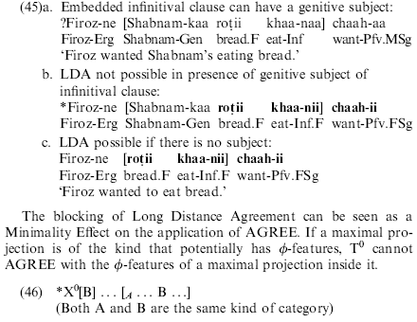
Two morphemes vs one morpheme
45b shows that LDA is impossible with a genitive subject.
Bhatt argues that LDA is impossible in 45b
However, I found speakers (from Multan) who disagree
He would need an additional example to show an inherent gender for khaanii in the form ``khaanaa’’ with the ungrammatical agreement between ``rotii’’ and ``chaahii’’

Slide 25
Bhatt’s 2005 arguments against 2 local relations
There are two NA morpheme, only one of them LDA. The NA which Butt shows to be an NP is not the one that does LDA
A 2 local relation analysis like Butt’s 1993 makes incorrect predictions.

Slide 26
Bhatt 2005 says Butt 1993 predicts incorrectly:
(Bhatt 2005:788)
In a case where the agreeing [object NA] is the subject of the sentence Butt’s analysis predicts that the matrix verb can agree with NA.
This is impossible in Kashmiri (a non-parasitic language).
This needs to be tested in Lahori-Urdu
“Mohans seeing this film will be possible.”
Mohan ki filam dekhni to mumkin hogii

Slide 27
Tests for restructuring
See Bhatt p 779,
Butt uses Control anaphora and agreement
Bhatt uses NPI licensing with negation in the NA clause
Passives of diaa- can be passivized but still marks its complement with “–e”

Slide 28
Exploring the distribution of the two NA
Tests for the non-complementary distribution of the two potential NAs
Take arguments from Starke for English ING being one morpheme
If I conclude that they are complementary, I will have to break a stipulation in AGREE/Agree that it cant agree with uninterpretable features?

Slide 29
LDA trigger is inside the embedded clause
LDA still happens when there is scrambling and intervening adverbs, this suggest that the trigger for LDA is inside the embedded clause (Bhatt 2005:766)

Slide 30

Interesting: ``chaah’’ (lexical restructuring verb) doesn’t agree with matrix subject, unlike light verbs
In the non-perfective forms the restructuring verb chaah doesn’t agree with the matrix subject (shown in b), unlike auxiliaries. This is strange.
Cf: Mona kutte-ko dekhtii rehtii thii
Is this discussed by Bhatt, Mahajan or Butt?
I will come back to this later in the explorations, after showing a structural difference between lexical and functional restructuring.

Slide 31
Matrix verbs that do LDA
Caah ‘want’ (Bhatt/Mahajan:LDAoptional) ?
Aataa ‘come’ (Butt:LDAoptional) Light verb
Diaa ‘give’ (marks –naa as oblique) Light verb
Liyaa ‘take’ Light verb
Kiaa ‘do’ Light verb
Lagaa put/hit/attach? Light verb
Milaa? Meet Light verb
Auxiliaries:
Thaa ‘past’ Aux
Rahaa ‘progressive’ Aux
Gaa ‘future’ Aux
Huaa/hotaa ‘happen/copula” Aux?
Gaay ‘passive/gone/went’ got X-ed(no erg) Aux?Light verb?
baiTh `sit’ (no erg) Light verb

Slide 32


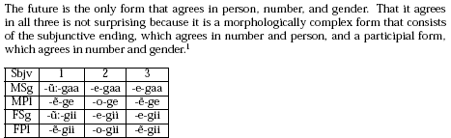
Agreement
From: bhatt-The Phenomenon of Long Distance Agreement(lecture)-2003.pdf
-taa,rahaa,(y)aa agree with gender and number like adjectives
Only be in the present tense and subjunctive agree with person and number
The future is formed with person-G-gender, it can be analyzed as the subjunctive+future participle
``The subjunctive ending and the participial form in the Hindi future are very closely bound now and no element may intervene between them. According to Kellogg (1893), in an earlier stage, certain focus particles could intervene between the subjunctive ending and the participial form.“

Slide 33
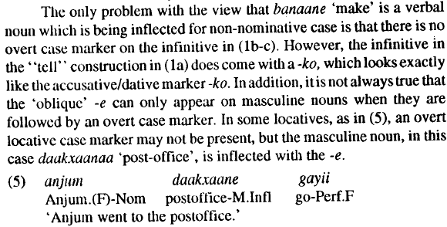
The oblique case
Can appear in some locatives with on overt marker (Butt 1993:54)

Slide 34
Agreement with the highest DP (not PP)
It is typically assumed that agreement in Hindi-Urdu is established with the highest unmarked argument. I propose a theoretical reason for this:
Case marked DPs have extra (blocking) structure
Case is marked with postpositions, no languages I know agree with PPs
``case-marking implies additional structure” (Bhatt 2005:783)
Other ergative Indo-Aryan languages do show agreement with case marked DPs, Nepali with ergative, Gujarati with accusative (Bhatt 2005:774).
If its an extra structural layer there should be some different properties that could be tested…

Slide 35
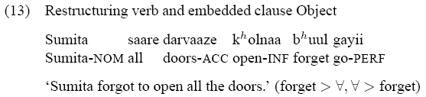
Examples of LDA
(Nevins & Anand 2003 13)

Slide 36
Matrix verbs that don’t do LDA

Slide 37
Noun/Verb cause/incoative pairs
Cikh/cikhna sneeze, sneezing
Baja/bajna/bajana horn,sound,sound-cause
Calta/calaanaa go/drive
gaanaa/gaanaa song/sing
Kaanaa/kaanaa food/eat
kaRak/kaRakna crackle/crackling
Kahani/kahaanaa story/tell
Dekaii/deknaa glimpse/see
D~aT/D~aTna teeth/scold
Bhuuk/bhuukii hunger/hungry(fem),(how do you say famine?)
Samajh/samjaa mind,brain?/understand

Slide 38
Noun roots
Majbur kar
Mumkin hai
Mehnat kar
Bhuul ja
Bhuuk lag
Tum is-ko Pasand kar,
mujhe is-ko pasand hai

Slide 39
Verb roots
Gaa sing
Kaa eat
PaRh study
maR hit
Soch think
Kah say/tell
Jaa go
D~aT scold
Bulaa call
Mil meet
PakaR catch

Slide 40
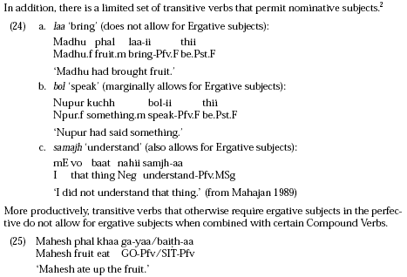
Verbs that don’t assign erg
Madhu phal laa-ii thii (Bhatt lecture)
Napur kuch bolii thii (Bhatt lecture)
mE vo baat nahii samjhaa (Mahajan 1989)
Gaya
baiTha
``A similar state of affairs is found in Marathi, and curiously with these very verbs. (pg. 132, Pandharipande (1997))”

Slide 41
Verbs with –KO subjects
Mujhe __ ataa
Usko samajh ataa
Mujhe ___ lagaa
Usko bhuuk lagaa
Mujhe pasand hai

Slide 42
Verbs with –KO objects
Maine us-ko [X karne-ko] kaha

Slide 43
Feminine nouns
Imlii tamarind
gaaRii car
roTii bread
Tehnii branch
Ghazal hymn
chiTThii letter
Kitaab book
Mehnat hardwork

Slide 44
NA clause can scramble
(Bhatt 2005:766)

Slide 45

NA can have CAUSE in it

Slide 46
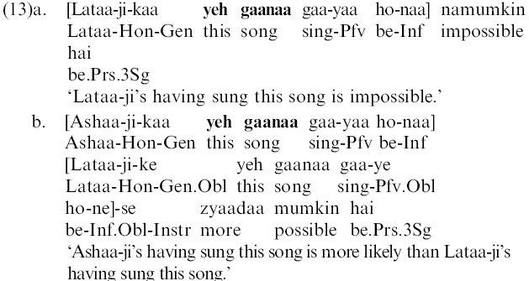
NA can have Aspect inside it
(Bhatt 2005 13a)

Slide 47
NA can have a genitive subject
(Bhatt 2005 13a,13b)

Slide 48
NA can be the object of a preposition
(Bhatt 2005 13b)

Slide 49
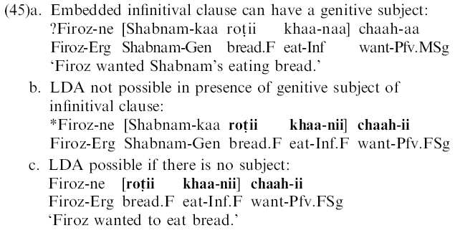

LDA NA cant have a genitive subject
(Bhatt 2005 45)
(Bhatt lecture 31) is a counter example??

Slide 50
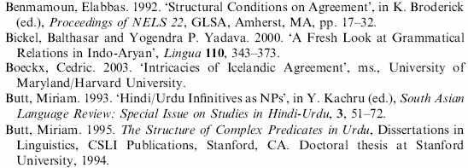
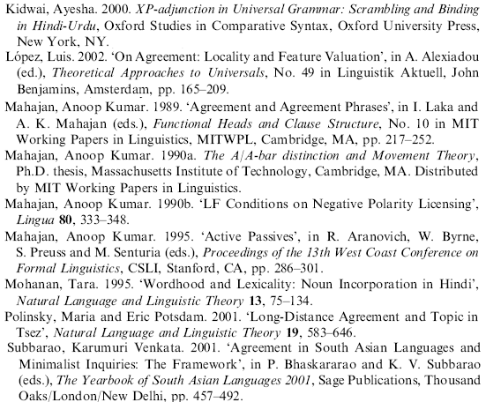

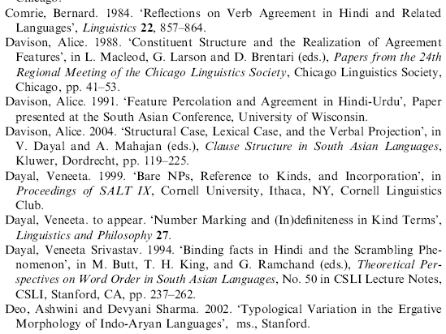
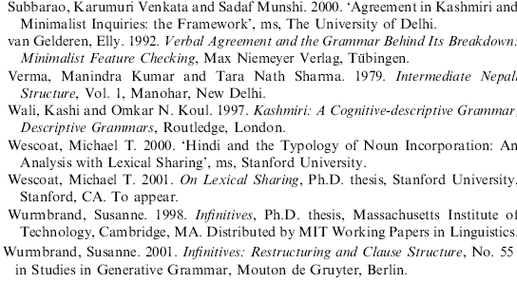
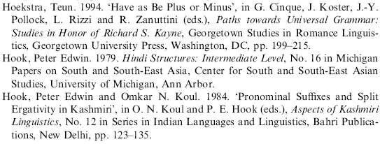
Bhatt 2005 References to Find

Slide 51
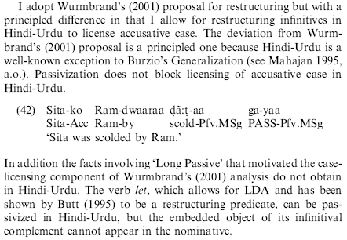
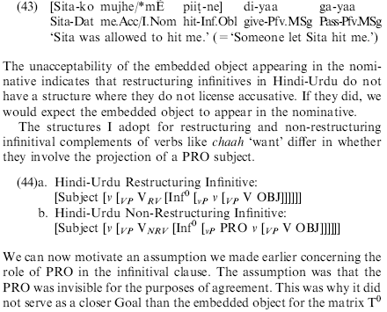
Hindi-Urdu has a passive: got x-ed ``x-aa gayaa’’
But its not completely like normal passives:
The by phrase is rare/non-existent in casual speech (Check this)
It still assigns –ko, although (following Icelandic) this is can be used as an argument that –ko is an Inherent Dative rather than an ACC marker.
It still allows the permissive ``diyaa’’ to assign oblique –e (this could be an argument that –e isnt a structural case.) This is a non-argument if the –e is actually the same as the subjunctive (which ``diyaa’’ would still subcategorizes for even when under ``gayaa’’)
Does it passivize the jaruu (ie, make it impossible to use jaruu except with dawara) in I hit him over the head with a stick?

Slide 52
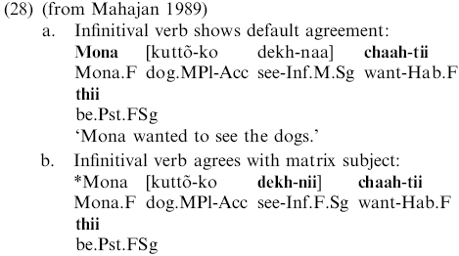
LDA does not agree with the matrix subject
Subject infinitives don’t agree with chahh
Check with informant: do they agree when `want’ is a lexical verb?
Pichle saal Mona apnii angutii chaahtii thii. Aj-kal, finally uske saas ki anguti us-ko sahii laktii hai.
Mona menge dupaTe bhii chaahtii thii.
Fahad to apnii angutii chaataa thaa
Do they agree when want has a gerund subject? Or this is always subjunctive..
Mujhe bell bajana chaahiye but I don’t want too….

Slide 53
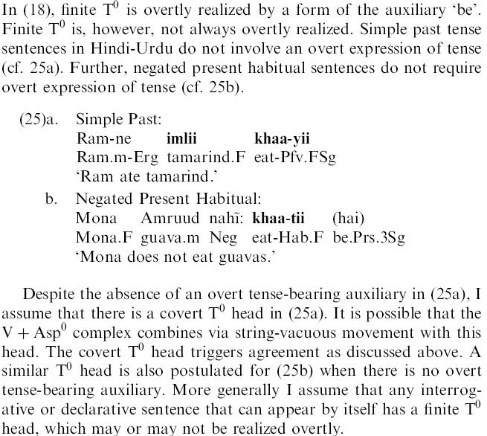
Finite T is not always realized
Finite T is not always realized, particularly in the past tense and in negated habituals.

Slide 54

Info about QR in Hindi-Urdu and, -ne and –ko subjects are different from null subjects
Nevins & Anand 2003 show that ergative subjects show scope freezing, unlike other subjects. Scope ambiguities can be derived by moving the Qb over Qa, followed by moving Qa over Qb. Following Johnson & Tomioka 1997, they argue that narrow scope is only possible when the higher quantifier reconstructs below the moved lower quantifier. EPP driven movement with no agreement (such as that of the ergative subject to spec TP), is unable to reconstruct. They “propose that there are in fact two heads [in the ECM construction?]: v (the equivalent of Lasnik’s AgrO), which assigns Case to the ECM subject, and HEPP , which only has an EPP feature. When HEPP is in the numeration, the subject moves; as there is no AGREE relation between the subject and HEPP , no reconstruction is possible.” (Nevins & Anand 2003:379)
“Dative subjects admit inverse scope readings” because they are structurally ambiguous.
“Sentences with ergative subjects admit both sentential and predicational negation readings” is consistant with other problems of placing negation in a rigid scope position in hindi. (Nevins & Anand 2003:375)
As LDA only exists with ergative subjects, the scope of the subject should always be high.
However, dative subjects marked with –ko can reconstruct because they are structurally ambiguous.
Check with informants: Find a restructuring verb which has a dative subject. This may be impossible as restructuring verbs typically assign nominative?
Can also check De-re,De-dicto scope

Slide 55
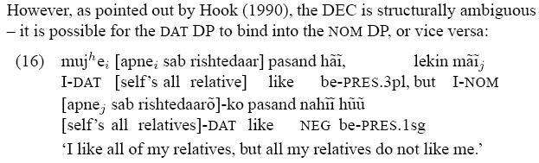
-KO subjects don’t show complete subject behavior
Hook 1990
Yes: Default word order
Yes: Control into adjuncts
No: structurally ambiguous
  it is possible for the DAT DP to bind into the NULL DP, or vice versa.?? Is this really a subject in pasand? It looks like pasand works like gustar, it can take a nomDP and a dativeDP, which can appear in either order? Pasand can also be a transitive verb: pasand karo

Slide 56
Hindi Negation is not a unique rigid head
Negation doesn’t appear to have a fixed scope position; it can license items it has never c-commanded.
Negation can license present tense auxiliary drop
Negation can license an NPI in all subjects
Possible explanations:
Neg-raising (I think this is a good option, it has the –hii emphatic marker on it which would raise no?)
Multiple merge positions for negation
As the position of negation is unclear, the fact that all subjects show scope ambiguities with negation doesn’t argue against Nevins & Anand 2003 PEPPER.

Slide 57
My random questions:

Slide 58
Object agreement seems different in urdu…
What if object agreement is the normal agreement in urdu?ie, verbs only agree with subjects if they start low (as themes) and move through/up to the projection which determines agreement.
Can there be default agreement in a finite clause with a female subject if the subject is the agent? (not experiencer)
can there be no genitive on an agent subject of –na?

Slide 59
Usne mujhe larki bana dia
Why is this masculine?
Try: “Actually in the play, usne muje larki bani di. I was so pissed…”

Slide 60
Agree shouldn’t use C-command
Ccommand isnt a primative (merge is) so agree shouldn’t use it, instead it should use percolate…

Slide 61
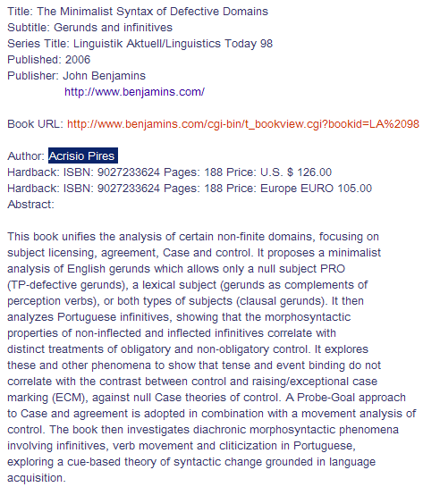
More references target january 31 for journal submission

Slide 62
Argument for Earliness might be used to argue that semantics is computed as structure is built
(and would be related to Agreement by Percolation.)
Nevins & Anand 2003 “Purely EPP Eliminates Reconstruction” generalization, or PEPPER):
(1) (PEPPER): A-movement only for EPP does not reconstruct.
Nevins and Anand argue that items that move without agreeing do not reconstruct: “presented evidence from several languages that there is a proscription on reconstruction of an argument from a head it does not AGREE with” (Nevins & Anand 2003:381)
Its rarely the case that we see EPP driven movement with no agreement. So its “when “subjecthood” and verbal agreement do not line up, the PEPPER restriction comes into play.” (Nevins & Anand 2003:381)
(32) ASAP Spellout: If a phrase XP contains no uninterpretable features, evaluate XP immediately.
“if the higher DP moves, it must keep widest scope. As it will do no further feature-checking, by (32), it should be interpreted as soon as possible.” “[I]f Earliness is violated to achieve a given interpretation… DPs that move ‘only for EPP’ cannot reconstruct; that is the only reason they moved in the first place!” (Nevins & Anand 2003:382)
“See McGinnis (2000) and Svenonius (2001) for different arguments for Earliness.”
McGinnis, Martha. 2000. Phases and the syntax of applicatives. In Proceedings of NELS 31. GLSA.
Svenonius, Peter. 2001.On object shift, scrambling, and the PIC.In A few from Building e39, ed. E. Guerzoni and O. Matushansky, 39. MIT Working Papers in Linguistics.

